Slide 2
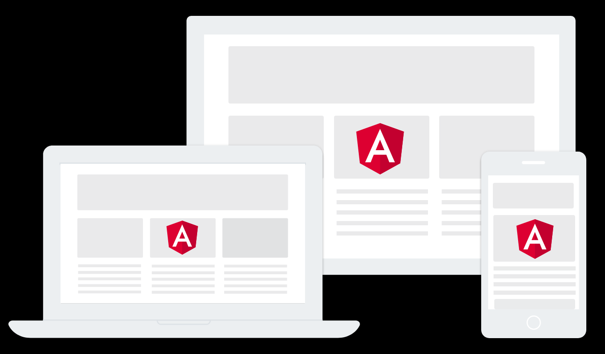
WHAT’S DYNAMIC COMPONENTS
“A technique for adding a component to the DOM at run time. Requires that you exclude the component from compilation and then connect it to Angular’s change-detection and event-handling framework when you add it to the DOM.” —— angular.io

Slide 3
STATIC COMPONENTS
Used in template
<app-header></app-header>
<app-breadcrumb></app-breadcrumb>
<form action="/REST/someAPI" method="POST">
<app-input [validators]="validators"></app-input>
<app-button (click)="submitForm($event)"></app-button>
</form>
<app-bottom-menu></app-bottom-menu>
<app-footer></app-footer>
Known in development time
Fixed location
Hard-coded

Slide 4
STATIC COMPONENTS
Used in template
<div *ngSwitch="component.type">
<app-profile *ngSwitchCase="profile" [data]="component.data">
</app-profile>
<app-card *ngSwitchCase="card" [data]="component.data">
</app-card>
<app-input *ngSwitchCase="input" [data]="component.data">
</app-input>
<app-button *ngSwitchCase="button" [data]="component.data">
</app-button>
...
...
...
</div>
Known in development time
Fixed location
Hard-coded

Slide 5
IMAGINE...
<div #viewcontainer></div>

Slide 6
DYNAMIC COMPONENTS
Added in run time
Load configuration from server
Lazy loaded
<div #viewcontainer></div>
@ViewChild(viewcontainer', { read: ViewContainerRef }) vcr;
constructor(private cfr: ComponentFactoryResolver) { }
const componentFactory = this. cfr.resolveComponentFactory(component);
// add the component to the view
const componentRef = this.container.createComponent(componentFactory);

Slide 7
DYNAMIC COMPONENTS
Where is the component inserted?
<div #viewcontainer></div>
@ViewChild(viewcontainer', { read: ViewContainerRef }) container;
How is it instantiated?
constructor(private cfr: ComponentFactoryResolver) { }
const componentFactory = this.cfr.resolveComponentFactory(component);
const componentRef = this.container.createComponent(componentFactory);

Slide 8
DYNAMIC COMPONENTS
How to pass inputs?
componentRef.instance.data = this.getData();
How to bind to outputs?
componentRef.instance.event.subscribe(observer);

Slide 9
COMPONENT INSTANTIATION
Popups
Dashboards

Slide 10
COMPONENT INSTANTIATION
NgModule
Declarations
SomeComponent
View
SomeComponent
Compile
SomeComponent
Factory
Create
Dom Node
Component
Instance
Render
Page
<app-profile *ngSwitchCase="profile" [data]="component.data">
</app-profile>
Element

Slide 11
COMPONENT INSTANTIATION
NgModule
Declarations
SomeComponent
View
Entry Components
SomeComponent
Compile
SomeComponent
Factory
Create
Dom Node
Component
Instance
SomeComponent
Host Factory
Render
Page
const componentFactory = this.cfr.resolveComponentFactory(component);
const componentRef = this.container.createComponent(componentFactory);
Element

Slide 14

Thanks！

